Slide 1
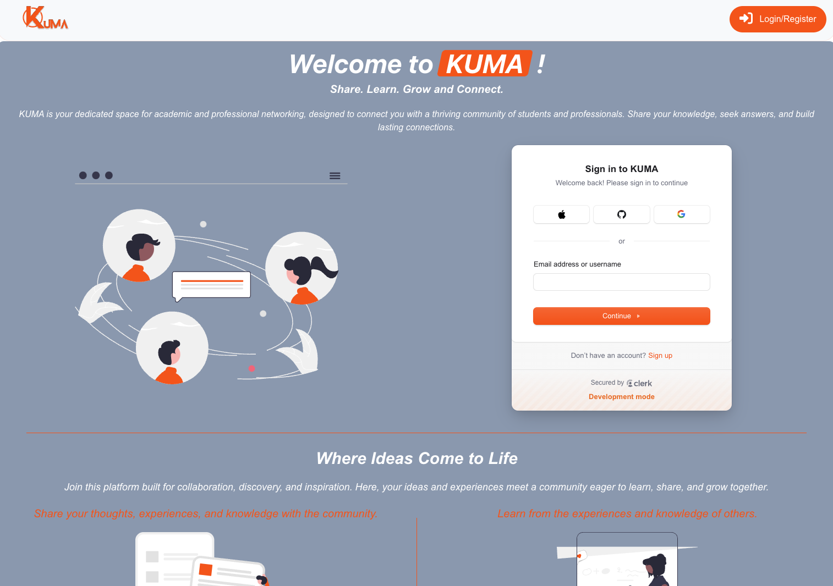

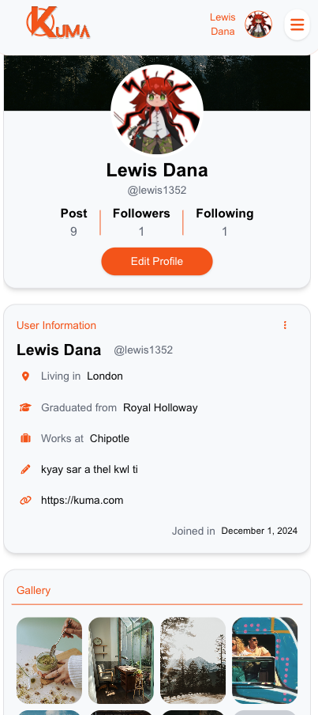
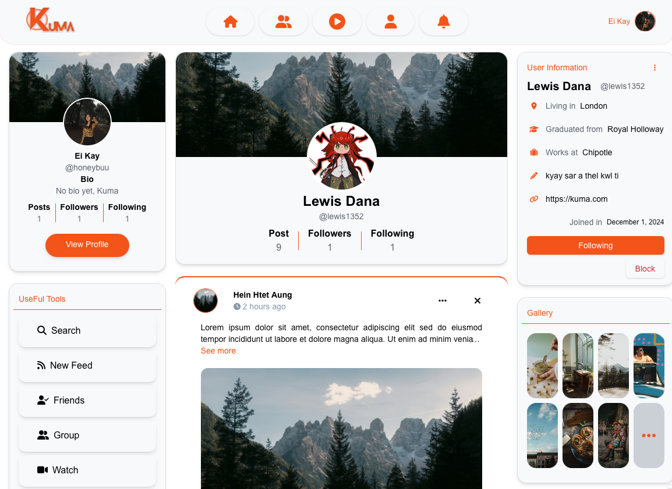
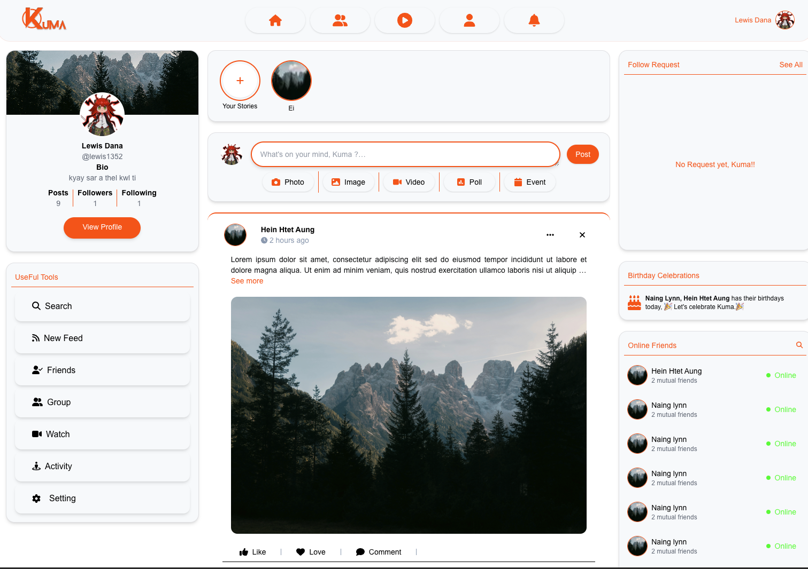
ADVANCED WEB DEVELOPMENT SOCIAL MEDIA WEBSITE - KUMA
DANA KHAING
SUPERVISED BY LLIA NOURETDINOV
DEPARTMENT OF COMPUTER SCIENCE
ROYAL HOLLOWAY, UNIVERSITY OF LONDON

Slide 2
ADVANCED WEB DEVELOPMENT SOCIAL MEDIA WEBSITE - KUMA
DANA KHAING
SUPERVISED BY LLIA NOURETDINOV
DEPARTMENT OF COMPUTER SCIENCE
ROYAL HOLLOWAY, UNIVERSITY OF LONDON

Slide 3


What is KUMA?
Scalable and secure social media platform.
Focus on user interaction, real-time content sharing.
Aim for engaging community for knowledge-sharing and discussion.
Why KUMA Matters
Increasing influence of social media on community and interaction
Growing demand for secure, user-friendly platforms
Scalable Solution: scale seamlessly without compromising performance.
What Make KUMA Different?
Faster Performance: optimized framework for superior speed and responsiveness.
User-centric design: seamless interaction with intuitive UI/UX
Enhanced security and data privacy.

Slide 4
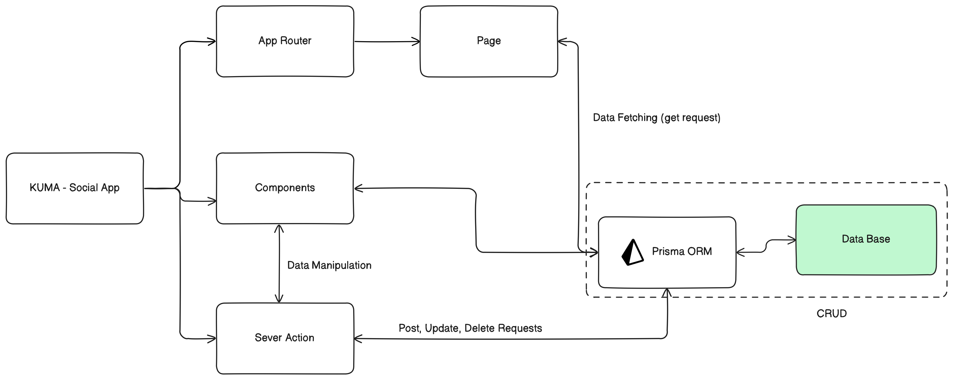
Key challenges Addresses by KUMA
Optimizing performance under heavy traffic
Ensuring robust security protocols
Seamless integration of user features
Technologies Used so far
Next.js: Server-side rendering (SSR) and static site generation (SSG) for fast loading and SEO
Prisma: Database management and type-safe queries
MySQL: Relational database
Clerk: User authentication and management and real-time synchronization of user data
This presentation will cover
Key concepts and technical highlights
Development progress
Forthcoming plan

Slide 5
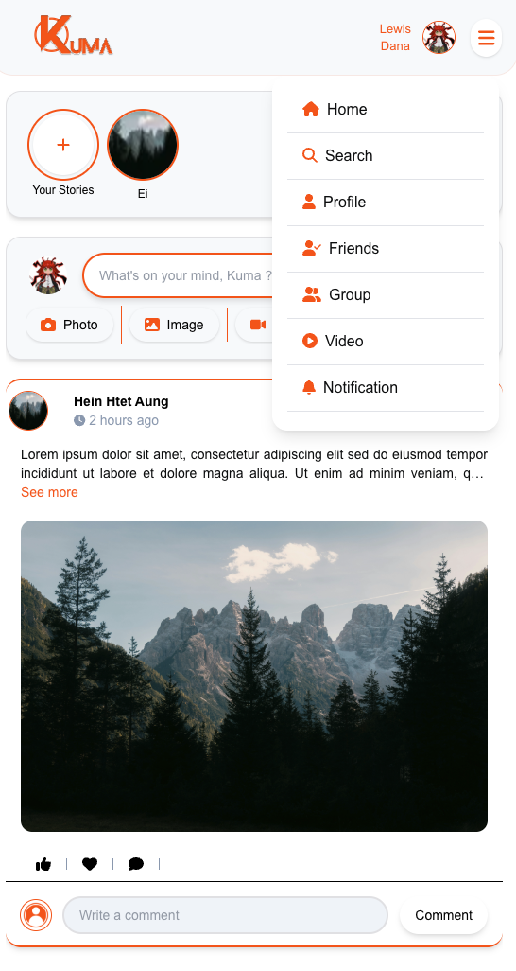
UI Design
1. User Interface focus
Intuitive Navigation: Easy-to-use and clean layout with quick access to key feature.
Responsive Design: UI is designed to ensure user experience on all screen size.
Mobile Optimization: Adjusted for smaller screens without losing functionality.
2. Visual Elements
Branding : Simple, modern design enhancing user engagement.
Colour Scheme : vibrant and modern feel while ensuring clarity and ease of use.
Icons and Graphics: Clear, visually appealing icons for user action.
3. User Experience (UX)
Fast Loading Time: Take advantages of Next.js sever action on content-heavy pages.
Feedback: Immediate feedback from action. (Buttons changing, Loading spinners)

Slide 6
UI Design
1. User Interface focus
Intuitive Navigation: Easy-to-use and clean layout with quick access to key feature.
Responsive Design: UI is designed to ensure user experience on all screen size.
Mobile Optimization: Adjusted for smaller screens without losing functionality.
2. Visual Elements
Branding : Simple, modern design enhancing user engagement.
Colour Scheme : vibrant and modern feel while ensuring clarity and ease of use.
Icons and Graphics: Clear, visually appealing icons for user action.
3. User Experience (UX)
Fast Loading Time: Take advantages of Next.js sever action on content-heavy pages.
Feedback: Immediate feedback from action. (Buttons changing, Loading spinners)

Slide 7
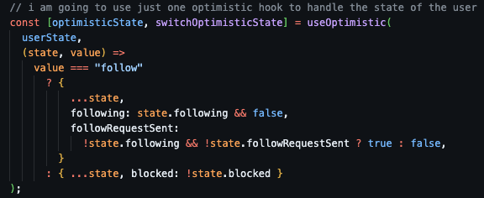
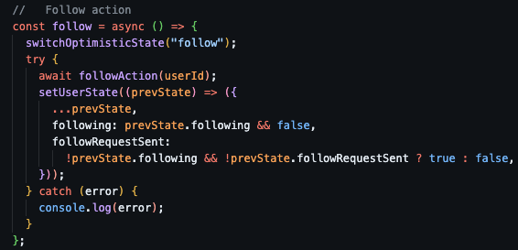
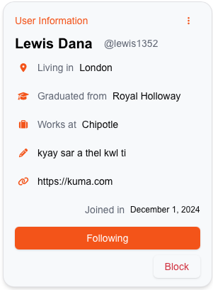
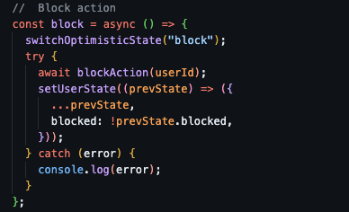
Optimistic UI
Instant UI Updates: UX immediate changes without waiting server responses.
Improved User Experience: Minimizes delays and provides faster action.
State Management: Predict outcomes of user actions and update UI instantly.
Error Handling: UI reverts to the previous state without user confusion.

Slide 8
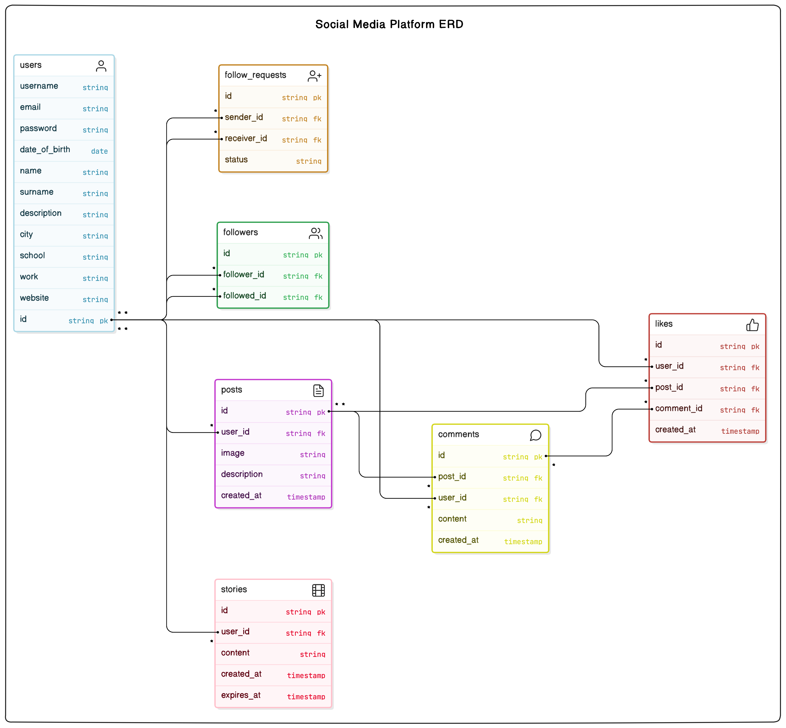
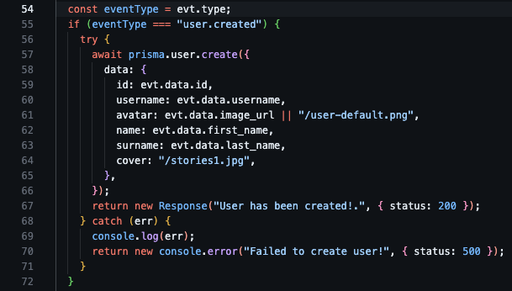
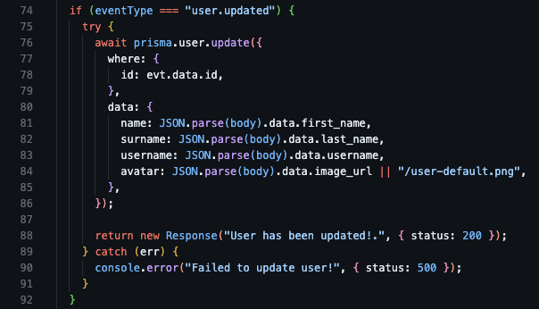
Database Design and User Management
Database design
Structure: MySQL with Prisma ORM for efficient and scalable data handling.
Key Models: User, Post, Likes, Comments, Stories, Followers, FollowRequest, Block.
Clerk Integration for User Management
Used Clerk’s API endpoints to sync user data form Clerk directly into the MySQL database.
Real-Time Data Syncing via Clerk webhooks to ensure updated user info in the database.

Slide 9
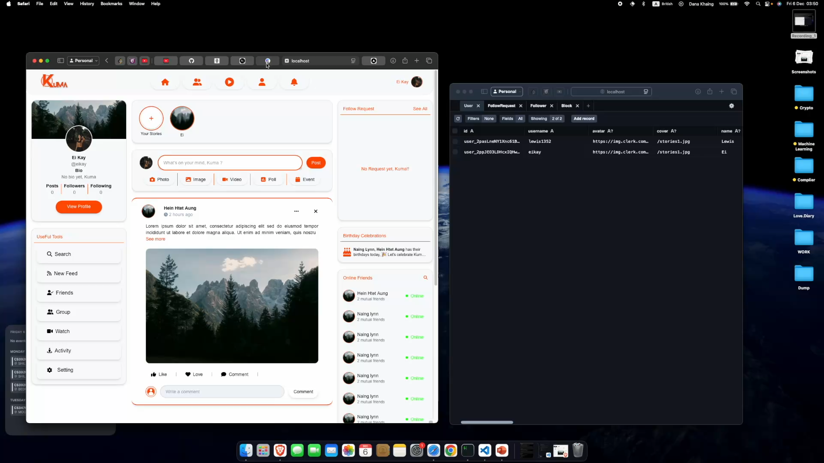
Demonstration

Slide 10

Progress So Far
UI Completion
Finalized a responsive and mobile-friendly UI.
Designed and implemented intuitive components.
User Authentication and Profile Management
Implemented secure auth using Clerk.
Database Integration
Created and optimized database tables using Prisma
Successfully synced user data from Clerk to MySQL.
Feature Development
Developed follow request, request accept or reject, and block features.
Used useOptimistic for faster user action handling.
Syncing the results of the user action to the database.

Slide 11

Future Planning
Enhancing security to prevent vulnerabilities: input validation and sanitization.
Further optimizing database queries: Using indexes and optimizing joins.
Adding more interactive features: Real-time notifications, group feature and messaging.
Focus on Performance and User Experience.
Summary
KUMA, social media platform designed for secure, scalable, and interactive user experiences.
Responsive UI.
Real-time user action features with secure user authentication.
Focus on performance and security for growing user engagement.

